Slide 1
Peer-to-Peer (P2P) Networks
Dr. Yingwu Zhu

Slide 2
Overview
CS Architecture
P2P Architecture
Unstructured P2P Networks
  Napster, Gnutella, KaZza, Freenet
  BitTorrent
Structured P2P Networks
  Chord, Pastry, Tapestry, CAN
  Won’t be covered here!

Slide 3
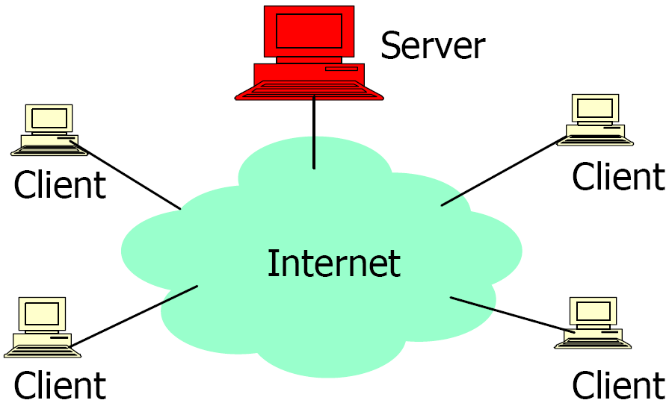
Client/Sever Architecture
Well known, powerful, reliable server is a data source
Clients request data from server
Very successful model
  WWW (HTTP), FTP, Web services, etc.
As more clients are added, the demand on
the server increases!!!

Slide 4
Client/Server Limitations
Scalability is hard to achieve
Presents a single point of failure
Requires administration
Unused resources at the network edge
  CPU cycles, storage, etc.
P2P systems try to address these limitations

Slide 5
Why Study P2P?
Huge fraction of traffic on networks today
  >=50%!
Exciting new applications
Next level of resource sharing
  Vs. timesharing, client-server, P2P
  E.g. Access 10’s-100’s of TB at low cost.

Slide 6
Users and Usage
60M users of file-sharing in US
  8.5M logged in at a given time on average
814M units of music sold in US last year
  140M digital tracks sold by music companies
As of Nov, 35% of all Internet traffic was for BitTorrent, a single file-sharing system
Major legal battles underway between recording industry and file-sharing companies

Slide 7
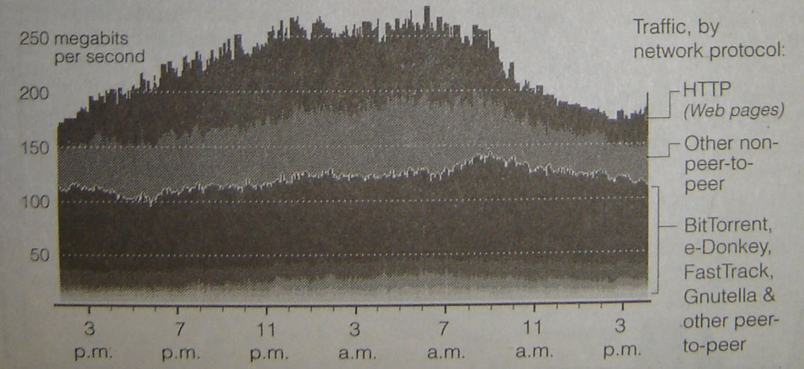
Share of Internet Traffic

Slide 8
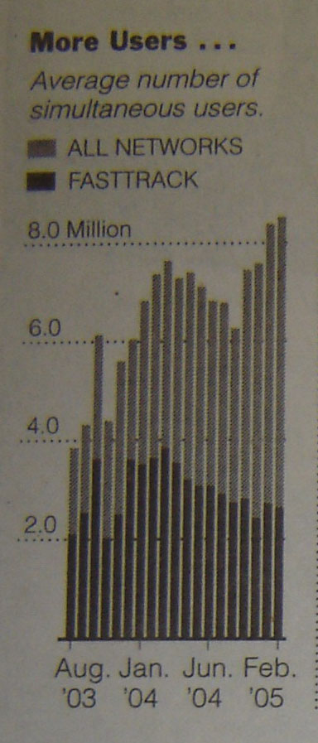
Number of Users
Others include
BitTorrent,
eDonkey, iMesh,
Overnet, Gnutella
BitTorrent (and
others) gaining share
from FastTrack (Kazaa).

Slide 9
P2P Computing
P2P computing is the sharing of computer resources and services by direct exchange between systems.
These resources and services include the exchange of information, processing cycles, cache storage, and disk storage for files.
P2P computing takes advantage of existing computing power, computer storage and networking connectivity, allowing users to leverage their collective power to the “benefit” of all.

Slide 10
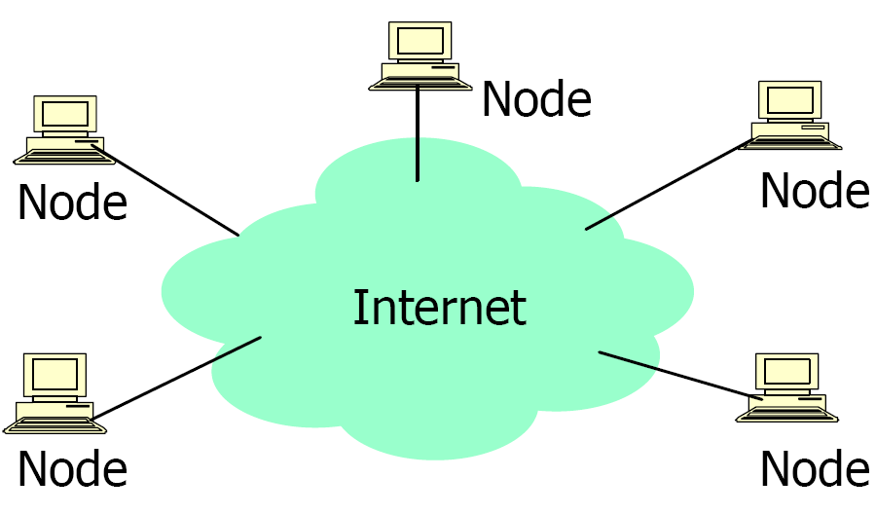
P2P Architecture
All nodes are both clients and servers
  Provide and consume data
  Any node can initiate a connection
No centralized data source
  “The ultimate form of democracy on the Internet”
  “The ultimate threat to copy-right protection on the Internet

Slide 11




What is P2P?
A distributed system architecture
  No centralized control
  Typically many nodes, but unreliable and heterogeneous
  Nodes are symmetric in function
  Take advantage of distributed, shared resources (bandwidth, CPU, storage) on peer-nodes
  Fault-tolerant, self-organizing
  Operate in dynamic environment, frequent join and leave is the norm
Internet

Slide 12
P2P Network Characteristics
Clients are also servers and routers
  Nodes contribute content, storage, memory, CPU
Nodes are autonomous (no administrative
authority)
Network is dynamic: nodes enter and leave the network “frequently”
Nodes collaborate directly with each other (not through well-known servers)
Nodes have widely varying capabilities

Slide 13
P2P vs. Client/Server
Pure P2P:
  No central server
  For certain requests any peer can function as a client, as a router, or as a server
  The information is not located in a central location but is distributed among all peers
  A peer may need to communicate with multiple peers to locate a piece of information
As more peers are added, both demand
and capacity of the network increases !

Slide 14
P2P Benefits
Efficient use of resources
  Unused bandwidth, storage, processing power at the edge of the network
Scalability
  Consumers of resources also donate resources
  Aggregate resources grow naturally with utilization
Reliability
  Replicas
  Geographic distribution
  No single point of failure
Ease of administration
  Nodes self organize
  No need to deploy servers to satisfy demand (c.f. scalability)
  Built-in fault tolerance, replication, and load balancing

Slide 15
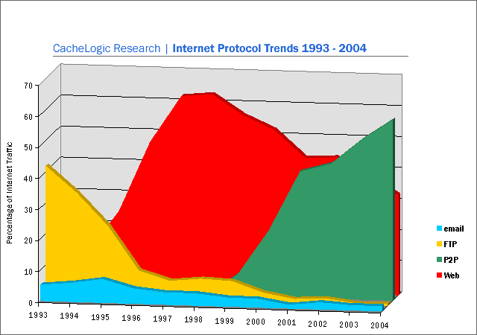
P2P Traffics
P2P networks generate more traffic than any other internet application
2/3 of all bandwidth on some backbones

Slide 16
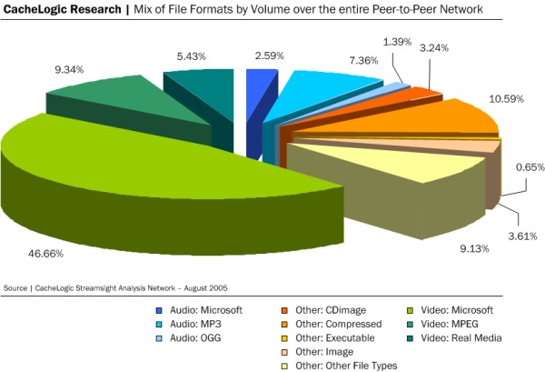
P2P Data Flow
CacheLogic P2P file format analysis (2005)
Streamsight used for Layer-7 Deep Packet Inspection

Slide 17
Category of P2P Systems
Unstructured
  No restriction on overlay structures and data placement
  Napster, Gnutella, Kazza, Freenet, Bittorrent
Structured
  Distributed hash tables (DHTs)
  Place restrictions on overlay structures and data placement
  Chord, Pastry, Tapestry, CAN

Slide 18
Napster
Share Music files, MP3 data
Nodes register their contents (list of files) and IPs with server
Centralized server for searches
  The client sends queries to the centralized server for files of interest
  Keyword search (artist, song, album, bitrate, etc.)
Napster server replies with IP address of users with matching files
File download done on a peer to peer basis
Poor scalability
Single point of failure
Legal issues → shutdown
Client
Client
Server
Reply
Query
File Transfer

Slide 19



Napster: Publish
insert(X,
123.2.21.23)
...
Publish
I have X, Y, and Z!
123.2.21.23

Slide 20
Napster: Search
123.2.0.18
search(A)
-->
123.2.0.18
Fetch
Query
Reply
Where is file A?

Slide 21
Napster
Central Napster server
  Can ensure correct results
  Bottleneck for scalability
  Single point of failure
  Susceptible to denial of service
    Malicious users
    Lawsuits, legislation
Search is centralized
File transfer is direct (peer-to-peer)

Slide 22
Gnutella: Query Flooding
Breadth-First Search (BFS)
= source
= forward
query
= processed
query
= found
result
= forward
response

Slide 23
Gnutella: Query Flooding
A node/peer connects to a set of Gnutella neighbors
Forward queries to neighbors
Client which has the Information responds.
Flood network with TTL for termination
+ Results are complete
– Bandwidth wastage

Slide 24
Gnutella vs. Napster
Decentralized
  No single point of failure
  Not as susceptible to denial of service
  Cannot ensure correct results
Flooding queries
  Search is now distributed but still not scalable

Slide 25
Gnutella: Random Walk
Improved over query flooding
Same overly structure to Gnutella
Forward the query to random subset of it neighbors
+ Reduced bandwidth requirements
– Incomplete results
– High latency
Peer nodes

Slide 26
Kazza (Fasttrack Networks)
Hybrid of centralized Napster and decentralized Gnutella
Super-peers act as local search hubs
  Each super-peer is similar to a Napster server for a small portion of the network
  Super-peers are automatically chosen by the system based on their capacities (storage, bandwidth, etc.) and availability (connection time)
Users upload their list of files to a super-peer
Super-peers periodically exchange file lists
You send queries to a super-peer for files of interest
  The local super-peer may flood the queries to other super-peers for the files of interest, if it cannot satisfy the queries.
Exploit the heterogeneity of peer nodes

Slide 27
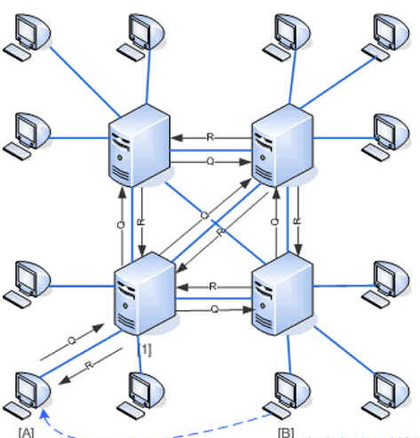
Kazza
Uses supernodes to improve
scalability, establish hierarchy
Uptime, bandwidth
Closed-source
Uses HTTP to carry out download
Encrypted protocol; queuing, QoS

Slide 28
KaZaA: Network Design
“Super Nodes”

Slide 29
KaZaA: File Insert
insert(X,
123.2.21.23)
...
Publish
I have X!
123.2.21.23

Slide 30
KaZaA: File Search
search(A)
-->
123.2.22.50
search(A)
-->
123.2.0.18
123.2.22.50
Query
Replies
Where is file A?
123.2.0.18

Slide 31
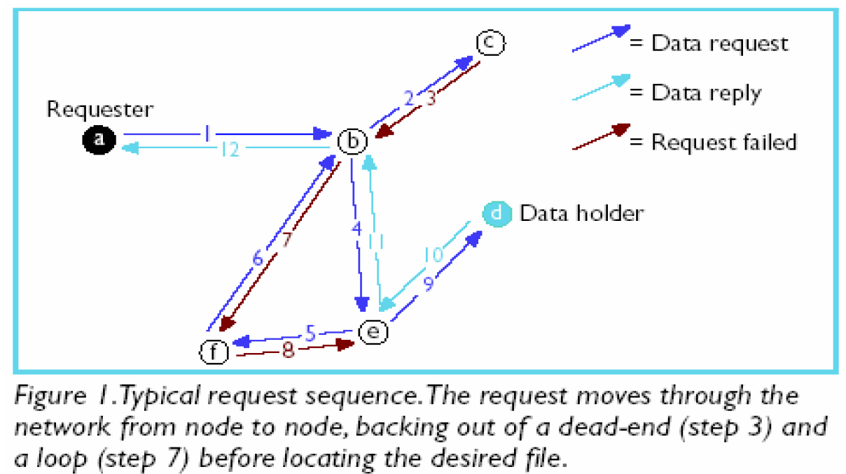
Freenet
Data flows in reverse path of query
  Impossible to know if a user is initiating or forwarding a query
  Impossible to know if a user is consuming or forwarding data
“Smart” queries
n Requests get
routed to
correct peer
by
incremental
discovery

Slide 32
Bittorrent
A popular P2P application for file exchange!

Slide 33
Problems to Address
Traditional Client/Server Sharing
  Performance deteriorates rapidly as the number of clients increases
Free-riding in P2P network
  Free riders only download without contributing to the network.

Slide 34
Basic Idea
Chop file into many pieces
  A piece is broken into sub-pieces ... typically 16KB in size
  Policy: Until a piece is assembled, only download sub-pieces for that piece
  This policy lets complete pieces assemble quickly
Replicate DIFFERENT pieces on different peers as soon as possible
As soon as a peer has a complete piece, it can trade it with other peers
Hopefully, we will be able to assemble the entire file at the end

Slide 35
File Organization
File
1
2
3
4
Piece
256KB
Block
16KB
Incomplete Piece

Slide 36
Overall Architecture
Web Server
Tracker
Web page
with link
to .torrent
.torrent
C
A
Peer
[Seed]
Peer
[Leech]
Downloader
“US”
B
Peer
[Leech]

Slide 37
Overall Architecture
Web Server
Tracker
Web page
with link
to .torrent
Get-announce
C
A
Peer
[Seed]
Peer
[Leech]
Downloader
“US”
B
Peer
[Leech]

Slide 38
Overall Architecture
Web Server
Tracker
Web page
with link
to .torrent
Response-peer list
C
A
Peer
[Seed]
Peer
[Leech]
Downloader
“US”
B
Peer
[Leech]

Slide 39
Overall Architecture
Web Server
Tracker
Web page
with link
to .torrent
Shake-hand
C
A
Peer
[Seed]
Peer
[Leech]
Downloader
“US”
Shake-hand
B
Peer
[Leech]

Slide 40
Overall Architecture
Web Server
Tracker
Web page
with link
to .torrent
pieces
C
A
pieces
Peer
[Seed]
Peer
[Leech]
Downloader
“US”
B
Peer
[Leech]

Slide 41
Overall Architecture
Web Server
Tracker
Web page
with link
to .torrent
pieces
C
A
pieces
Peer
[Seed]
Peer
[Leech]
Downloader
“US”
pieces
B
Peer
[Leech]

Slide 42
Overall Architecture
Web Server
Tracker
Web page
with link
to .torrent
Get-announce
Response-peer list
pieces
C
A
pieces
Peer
[Seed]
Peer
[Leech]
Downloader
“US”
pieces
B
Peer
[Leech]

Slide 43

Critical Elements
1 A web server
  To provide the ‘metainfo’ file by HTTP
  For example:
    http://bt.btchina.net
    http://bt.ydy.com/
Web Server
The Lord of Ring.torrent
Troy.torrent

Slide 44

Critical Elements
2 The .torrent file
  Static ‘metainfo’ file to contain necessary information :
    Name
    Size
    Checksum
    IP address (URL) of the Tracker
    Pieces <hash₁,hash₂,….hash_{n}>
    Piece length
Matrix.torrent

Slide 45
Critical Elements
3 A BitTorrent tracker
  Non-content-sharing node
  Track peers
  For example:
    http://bt.cnxp.com:8080/announce
    http://btfans.3322.org:6969/announce
Peer cache
  IP, port, peer id
State information
  Completed
  Downloading
Returns random list

Slide 46
Critical Elements
4 An end user (peer)
  Guys who want to use BitTorrent must install corresponding software or plug-in for web browsers.
  Downloader (leecher) : Peer has only a part ( or none ) of the file.
  Seeder: Peer has the complete file, and chooses to stay in the system to allow other peers to download

Slide 47
Messages
Peer – Peer messages
  TCP Sockets
Peer – Tracker messages
  HTTP Request/Response

Slide 48


BitTorrent – joining a torrent
metadata file
.torrent
new leecher
website
1
2
join
peer list
3
data
request
seed/leecher
tracker
4
Peers divided into:
seeds: have the entire file
leechers: still downloading
1. obtain the metadata file
2. contact the tracker
3. obtain a peer list (contains seeds & leechers)
4. contact peers from that list for data

Slide 49
BitTorrent – exchanging data
leecher B
leecher A
I have
!
seed
leecher C
● Verify pieces using hashes
● Download sub-pieces in parallel
● Advertise received pieces to the entire peer list
● Look for the rarest pieces

Slide 50
BitTorrent - unchoking
leecher B
leecher A
seed
leecher C
leecher D
● Periodically calculate data-receiving rates
● Upload to (unchoke) the fastest downloaders
● Optimistic unchoking
  periodically select a peer at random and upload to it
  continuously look for the fastest partners

Slide 51




Demo
HTTP GET MYFILE.torrent
MYFILE.torrent
webserver
http://mytracker.com:6969/
S3F5YHG6FEB
FG5467HGF367
F456JI9N5FF4E
…
user
“register”
list of peers
ID1 169.237.234.1:6881
ID2 190.50.34.6:5692
ID3 34.275.89.143:4545
…
ID50 231.456.31.95:6882
tracker
…
Peer 40
Peer 1
Peer 2

Slide 52
Swarming Pieces and Sub-pieces
A piece, typically 256KB is broken into 16KB sub-pieces.
Until a piece is assembled, only sub-pieces for that piece is downloaded.
This ensures that complete pieces assemble quickly.
When transferring data over TCP, it is critical to always have several requests pending at once, to avoid a delay between pieces being sent.
At any point in time, some number, typically 5, are requested simultaneously.
On piece completion, notify all (neighbor) peers.

Slide 53
Piece Selection
The order of pieces is very important for good performance.
A bad algorithm could result in all peers waiting for the same missing piece.
Random Piece First policy
  Initially a peer had no pieces to trade, thus important to get a piece ASAP.
  Policy: Peer starts with a random piece to download.
Rarest Piece First policy
  Policy: Download the pieces which are most rare among your peers.
  Ensures most common pieces are left for last.

Slide 54
Rarest First Policy
Peer
HAVE <12,7,36>
12,7,36
12,7,14
Peer
HAVE <14>
.
.
.
14
Peer
HAVE <12,7,14>

Slide 55
End Game mode
When all the sub-pieces that a peer doesn’t have are requested, a request is sent to every peer.
When the sub-piece arrives, duplicate requests are canceled.
This ensures, completion is not prevented due to a slow peer.

Slide 56
Tit-for-Tat Strategy
“Give and yet shall receive”
Cooperate if the other per cooperates.
Chocking mechanism.
Choke all peers except top 4 up loaders.
Optimistic Un-choke for eventual cooperation and recovery.

Slide 57
Tit-for-Tat
Peer 1 Un-choked
Peer 2 Choked
Peer
Peer 1
Slow Upload
Peer 2
Peer 1 Choked
Peer 2 Un-choked

Slide 58
Choking
Ensures every nodes cooperate and prevents free-riding problem.
Goal is to have several bidirectional connections running continuously.
Choking is temporary refusal to upload, downloading occurs as normal.
Connection is kept open so that setup costs are not borne again and again.
At a given time only 4 best peers are un-choked.
Evaluation on whom to choke/un-choke is performed every 10 seconds.
Optimistic Un-choke every 30 seconds.
  Give a chance for newly joined peer to get data to download

Slide 59
Choking Algorithm
Goal is to have several bidirectional connections running continuously
Upload to peers who have uploaded to you recently
Unutilized connections are uploaded to on a trial basis to see if better transfer rates could be found using them

Slide 60
Choking Specifics
A peer always unchokes a fixed number of its peers (default of 4)
Decision to choke/unchoke done based on current download rates, which is evaluated on a rolling 20-second average
Evaluation on who to choke/unchoke is performed every 10 seconds
  This prevents wastage of resources by rapidly choking/unchoking peers
  Supposedly enough for TCP to ramp up transfers to their full capacity
Which peer is the optimistic unchoke is rotated every 30 seconds

Slide 61
Anti-Snubbing
Policy: When over a minute has gone by without receiving a single sub-piece from a particular peer, do not upload to it except as an optimistic unchoke
A peer might find itself being simultaneously choked by all its peers that it was just downloading from
Download will lag until optimistic unchoke finds better peers
Policy: If choked by everyone, increase the number of simultaneous optimistic unchokes to more than one

Slide 62
Up-load only or Seeding mode
Once the download is complete, has no download rates to compare, nor requires them.
Which node to upload?
Policy: Upload to top 4 peers with maximum upload rate.
  Ensures faster replication.

Slide 63
Structured P2P Networks
Distributed Hash Tables (DHTs)
  put(k,v) and v=get(k) interface
Representative systems
  Chord, Pastry, Tapestry, and CAN

